Slide 1
Measuring the improvements of hand-eye coordination with the assistance of virtual reality
Daniel Ben-Zaken, Steven Felker, Jake Greenberg

Slide 2
Virtual Reality and hand-eye coordination
Advancements in Virtual Reality (VR) has led to increased research opportunities
VR simulations improved performance of surgical technicians [12]
Physical and Cyber sicknesses have been mitigated as well [13]

Slide 3
Background
Developers of VR platforms compete to achieve the highest level of immersion possible for existing hardware
Some such examples are HTC Vive and Oculus Quest.
Research pertaining to Depth-Of-Field and Depth-Perception of users when active inside virtual environments has become a key milestone regarding the next step evolution of VR applications,
This focused on how users perceive distance and how different factors could affect perceived distance in a VR setting [3, 4, 5].

Slide 4
Pre-Survey
Was taken prior to participation in this study
This served as the users’ consent to participate in the study
Gathered general information such as gender and age
Also asked about their general knowledge of VR and AR

Slide 5

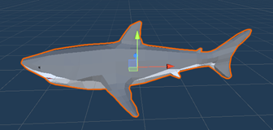
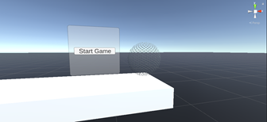
Application
Created a game in Unity where the player will have three lives to try to catch fish that fall from the sky.
If a player fails to catch a fish, one life will be deducted from the player
Once the player loses all three lives it will be game over

Slide 6
Hand-Eye Calibration
To assess the users' hand-eye coordination, we had the users play games of catch by throwing a ball against a wall for three minutes.
This was done both before and after the user partook in the actual application to better test whether the use of VR effected the user.

Slide 7
Post-Survey
Asked for general information about the application and their experience
Included subjective information about their experience, including:
Application Feel
Prior Experience Effect
Long form feedback

Slide 8
Results
All results were ported into RStudio, to allow for simple analysis and review.
Combined all results data into one dataframe, to simplify analysis.
Created a linear model to try and predict our test variable
Libaries Used:
tidyverse
ggplot2
ggpubr
kableExtra
Users were assigned a unique ID to allow joining

Slide 9

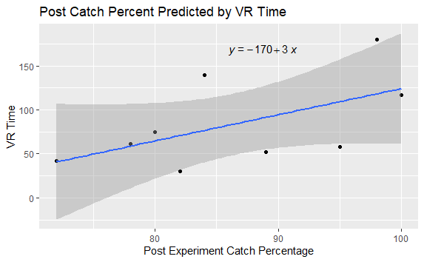
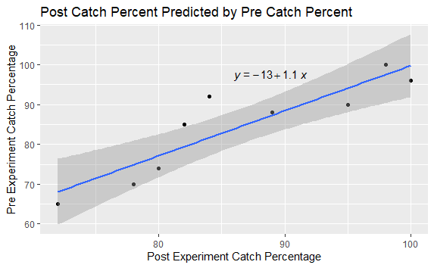
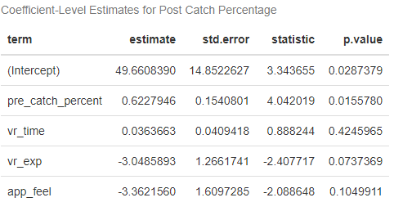
results

Slide 10
Conclusion and future work
Could not prove that VR applications are an effective method to improve hand-eye coordination using our experimental procedure
However, this did not disprove the hypothesis.
Unable to see significant changes in motor skills due to study’s short length
The application itself could also have been improved
Received an average 2.9/5 rating on post-survey.

